Slide 1



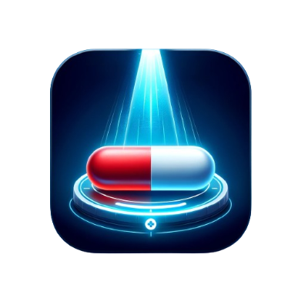
Gemini Show & Tell
PharmaScan
Extract medicine info with Gemini
Aashi Dutt
Nitin Tiwari
AI/ML GDE
AI/ML GDE

Slide 2
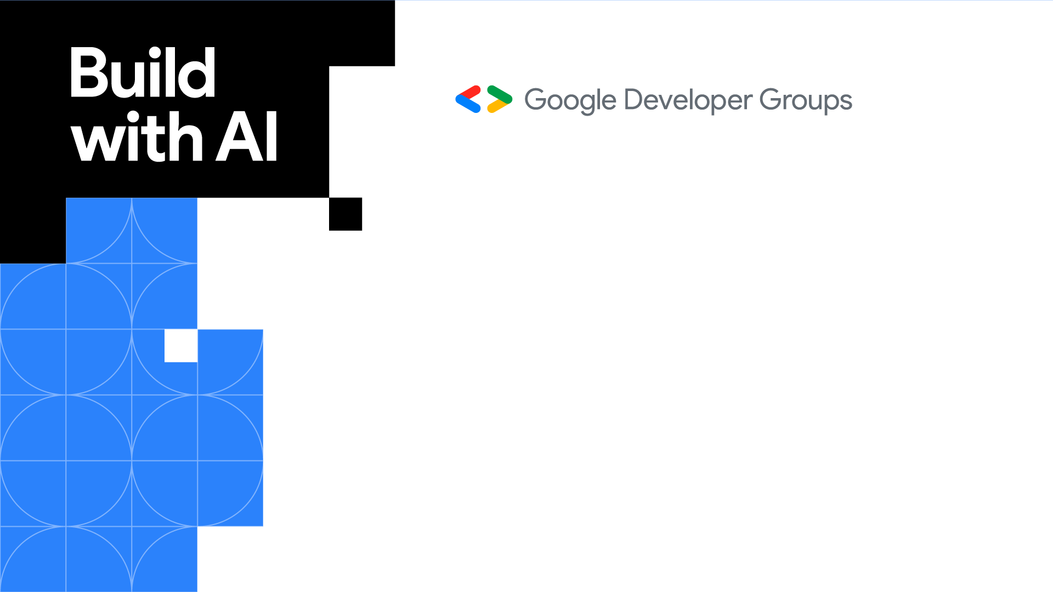
Why PharmaScan?

Slide 3
PharmaScan
Have you ever stumbled upon a medication tucked away in your first-aid kit or medicine cabinet and wondered, "What is this for again?”
PharmaScan is here to bridge that gap between medications and understanding.
It empowers individuals to easily access crucial information about their medications by simply using their smartphone camera.
With a quick scan, PharmaScan provides clear and concise details about the medication, including:
Purpose Why it is used, conditions it treats
Dosage Recommended dosage frequency for safe use
Usage Guidelines Dosage forms like tablet, capsule, liquid

Slide 4
Inspiration behind PharmaScan

Slide 5

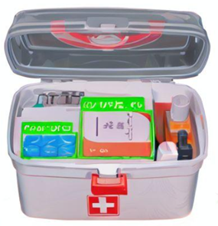
What is this used for? 💊
Inspired by the rising demand for reliable medication information, particularly among those with limited healthcare literacy or facing language barriers.
Provide quick information about medicines to the users regardless of their medical background.
Leveraging technology in healthcare: The image recognition and text extraction capabilities of Gemini Pro Vision model provided the foundation to create an accessible and efficient tool.

Slide 6
Tools & Products

Slide 7



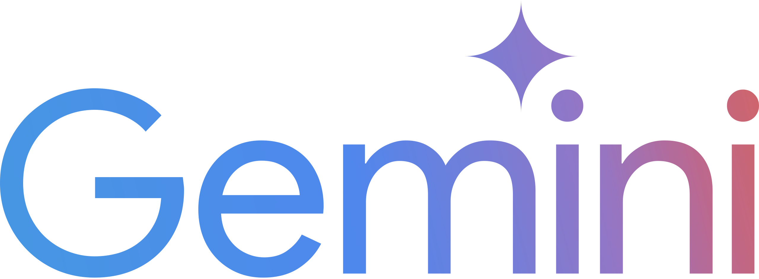
PharmaScan is available on Android and Hugging Face 🤗 Spaces.
Under the hood, PharmaScan uses the Gemini Pro Vision model to perform OCR and identify name of the medicine and provide its details.
Products used:
Gemini API
Google Colab
Google Cloud
Android Studio

Slide 8
<Behind the code>

Slide 9
Android SDK
// Configure API key and model.
val generativeModel = GenerativeModel(
modelName = "gemini-1.0-pro-vision-latest",
apiKey = BuildConfig.apiKey
)
// Pass the input image and text prompt.
val inputImage: Bitmap = // ...
val inputContent = content() {
image(inputImage)
text("Write a prescription in pointer format ordered by name of medicine, symptoms, primary diagnosis, usage and dosage of medicine in the image?")
}
// Generate response.
val response = generativeModel.generateContent(inputContent)
print(response.text)

Slide 10
Python
# Install the Gen AI SDK.
!pip install -q -U google-generativeai
import google.generativeai as genai
from PIL import Image
# Configure the API key.
genai.configure(api_key=API_KEY)
# Configure the model.
model = genai.GenerativeModel(model_name='gemini-pro-vision’)
# Load the image.
img = Image.open('/content/image.jpg’)
prompt = "Identify the place from the image."
# Give the input image and prompt, get response.
response = model.generate_content([prompt, img], stream=True)
# Print the response.
response.resolve()
print(response.text)

Slide 11
LIVE Demo

Slide 12
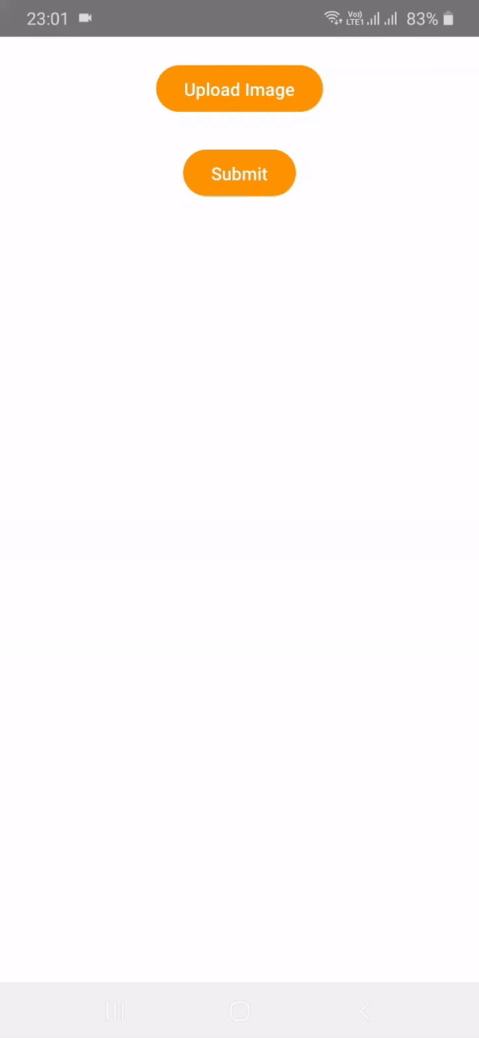
💊 PharmaScan : Extract medicine info using Gemini
PharmaScan is an Android application that leverages the Gemini Pro Vision model to identify medicines and provide their details such as usage, dosage, diagnosis, etc. on the go.
Check out on GitHub:
https://github.com/NSTiwari/Medicine-Scan-with-Gemini
Try it on Hugging Face 🤗:
https://huggingface.co/spaces/Aashi/Medicine-Prescription-with-Gemini
Watch the complete demo on YouTube:
https://www.youtube.com/watch?v=Q06ABLwFGTQ
If you liked our work, don’t forget to give a ⭐
to the repository.

Slide 13
Future Prospects

Slide 14
Future Prospects:
As of now, PharmaScan is just a proof-of-concept but we would love to see it getting enhanced with community contributions.
Personalized medication management: Providing reminders and alerts for medication schedules, potential drug interactions, and refills.
Accessibility features: Developing features for visually impaired users, such as audio output of medication information.
Combined capabilities of Gemini’s vision processing and Gemma’s text interpretation and response generation.
PharmaScan is open-sourced on GitHub.
We welcome contributions to enhance this project with new features. If you have any interesting ideas to add, please feel free to submit a pull request.

Slide 15
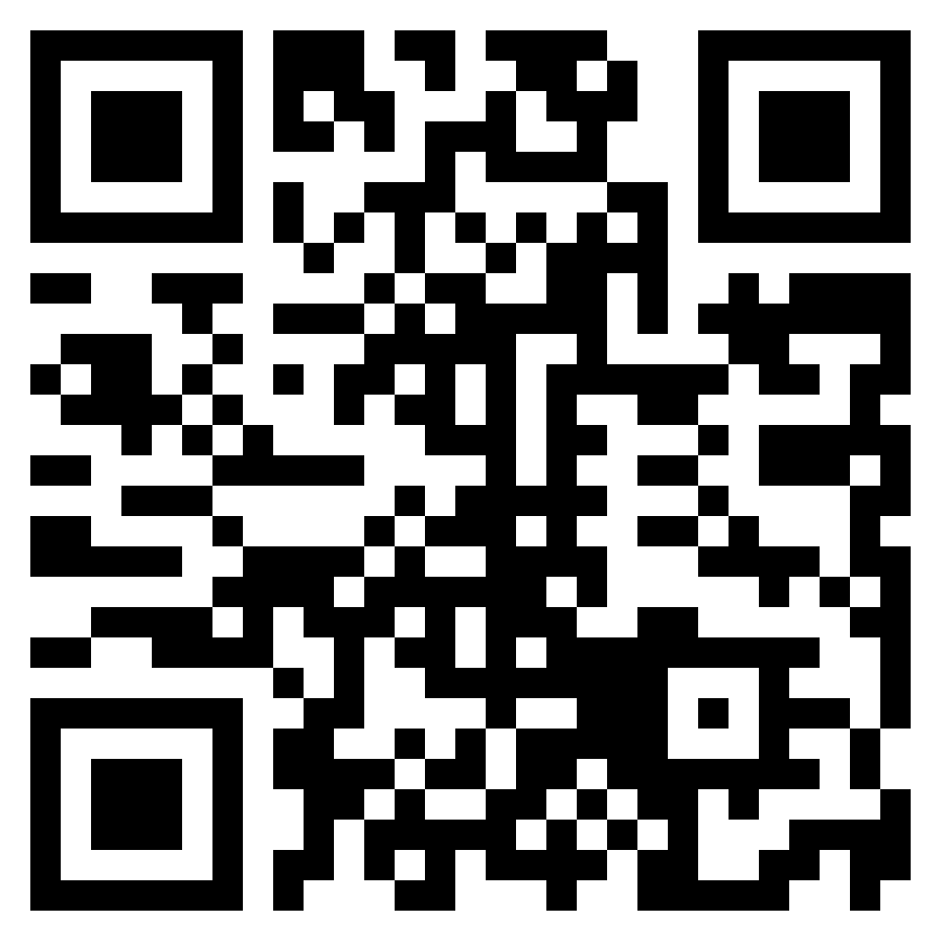
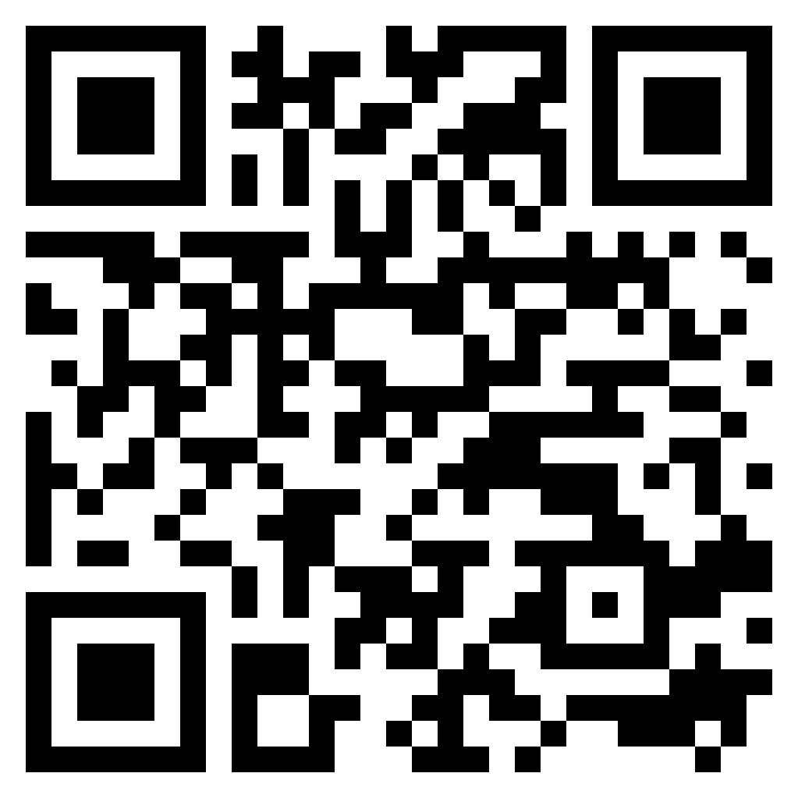
Thank You.
linkedin.com/in/aashi-dutt
linkedin.com/in/tiwari-nitin

